Slide 1
Module Title

Slide 2
What is Fast Arc

Slide 3
Benefits:<benefit>

Slide 4
Where do we start?

Slide 5
Lab Exercise:
<labName>

Slide 6
Example Module
Slides per What is…, Benefits…, and Where do we start… sections will vary

Slide 7
Shared Slaves

Slide 8
What are Shared Slaves?
A Jenkins build node configured to be “leased” to masters using CloudBees Jenkins Operations Center.
Slaves can be managed or unmanaged

Slide 9
What are Shared Slaves?
Shared slaves, just like typical Jenkins slaves, run build jobs using executors.
When a slave is connected to a master, all configured executors on the slave are available to that master.
Client masters can be configured to limit how many concurrent executors can be connected to them.

Slide 10
What are Shared Slaves?
Shared slaves can be connected to CJOC using the same connection methods as typical Jenkins slaves:
SSH
Java Web Start
Via a command on the master
As a Windows service

Slide 11
What are Shared Slaves?
Shared slaves can be configured to have availability policies as well:
Online as much as possible
Offline when idle
Online according to a schedule
Online when in demand

Slide 12
What are Shared Slaves?
Unlike typical slaves, shared slaves are treated by CJOC like jobs – dashboard level objects that can be configured, deleted, have role restrictions, and be placed into folders
Can be restricted to certain masters using folders
Shared slaves can be shared between masters, based on the masters’ slave policy and if any labels are configured.

Slide 13
What are Shared Slaves?
Shared slaves by default lease for one and only one job build before returning to the pool.
This is called a “one-shot” build mode.
If the slave/client master connection is interrupted, the client master will not be able to return the slave until the connection is re-established.
In this case, slave can be re-used by client master.

Slide 14
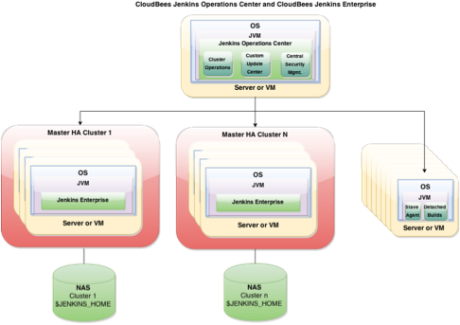
What are Shared Slaves?
Typical architecture with shared slaves

Slide 15
Benefit: scalability
Shared slaves are leased on demand to client masters, eliminating need to tie slaves to individual masters in a Jenkins installation
Shared slaves can be brought offline for maintenance with the click of a button
A cloud for shared slaves may be configured, e.g. vSphere
Allows slaves to be templatized instead of individually configured

Slide 16
Benefit: efficiency
Leasing slaves and only bringing them online when needed allows organizations to free up slave VMs/machines for other uses
No slave resource will be wasted – if one master is not using a given slave, it is free for another to use
Teams can share scarce specialty resources between masters – e.g. Windows/OSX slave machines

Slide 17
Where do we start?
The slaves you want to shared with CJOC will need to be accessible over TCP/IP
Port can be configured, random otherwise.
Port advertised in a special HTTP header.
Good practice to assume connecting slave does not have required tools installed
Include in build a step to install tools from an SCM like Subversion
Can cache tools on the master
Custom Tools Plugin – generic tool installer for jobs

Slide 18
Lab Exercise:
Creating Shared Slaves

